Slide 1
PREDICTING THE OCCURRENCE OF DIABETES IN PREGNANT WOMEN
Harini-18BCE1010 Shraddha-18BCE1070 Aanya-18BCE1067

Slide 2
Title
Visualising occurrence of diabetes.

Slide 3
Objective
To visualize and compare different prediction models to predict occurrence of diabetes in pregnant women.

Slide 4
Problem definition
Diabetes is a problem that lot of pregnant women are facing so we are collecting the data based on previous occurrences and applying different prediction models on it.There are many factors that may cause the occurrence of diabetes like no.of pregnancies,blood pressure,glucose ,BMI and age.A comparison of the accuracies of the different prediction models is also done to find the most apt model for the dataset.

Slide 5
Techniques
Python is used for the project.
Plotting techniques- For plotting,use library named matplotlib.Histogram and barplot will be used.
Data cleaning techniques- For the records that have 0 or NaN(where they have no meaning) , we will replace it by the median of that particular column.
Data splitting- Split data using stratify function ,which splits the data based on a particular column value ,ensuring that the outcome doesn’t vary every time the code is run.
Training and testing- Here we compare multiple classification algorithms such as KNN,Naïve Bayes and Logistic regression model.

Slide 6
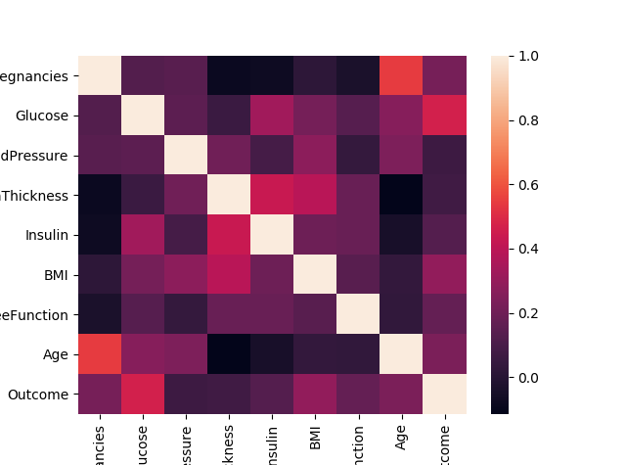
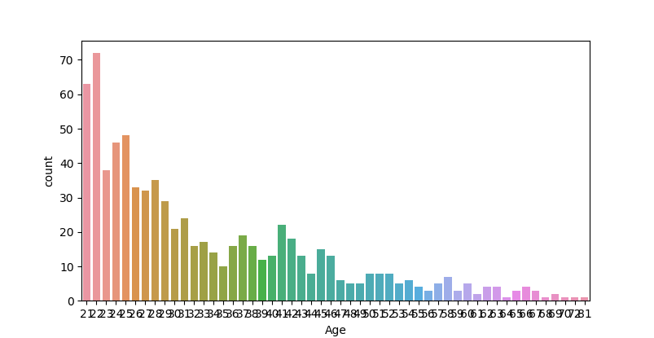
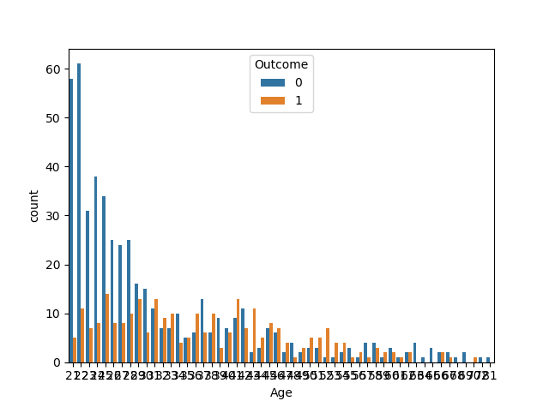
Visual Outputs: Feature Comparisons

Slide 7
Models Used
KNN model: The K-nearest neighbors (KNN) algorithm is a type of supervised machine learning algorithms. It is a lazy learning algorithm and it uses all of the data for training while classifying a new data point or instance.
Naïve Bayes: This model makes use of Bayes theorem finding the probability of an event occurring given the probability of another event that has already occurred.
Logistic Regression: It is basically a supervised classification algorithm used to assign observations to a discrete set of classes ,it assumes a linear relationship between the input variables and the output.
Decision Tree: Decision Tree algorithm belongs to the family of supervised learning algorithms. Unlike other supervised learning algorithms, decision tree algorithm can be used for solving regression and classification problems too. The general motive of using Decision Tree is to create a training model which can use to predict class or value of target variables by learning decision rules inferred from prior data(training data).
Random Forest: Random forest, like its name implies, consists of a large number of individual decision trees that operate as an ensemble. Each individual tree in the random forest spits out a class prediction and the class with the most votes becomes our model’s prediction

Slide 8
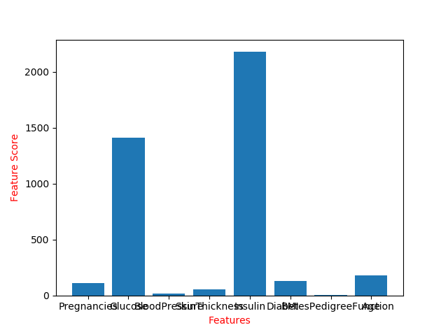
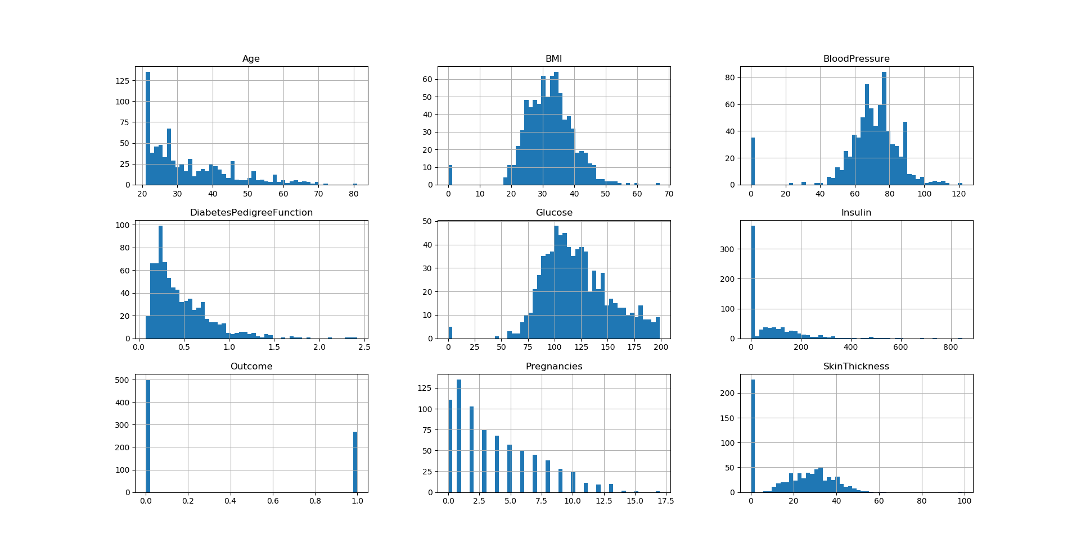
Visual Output: Feature Comparisons

Slide 9
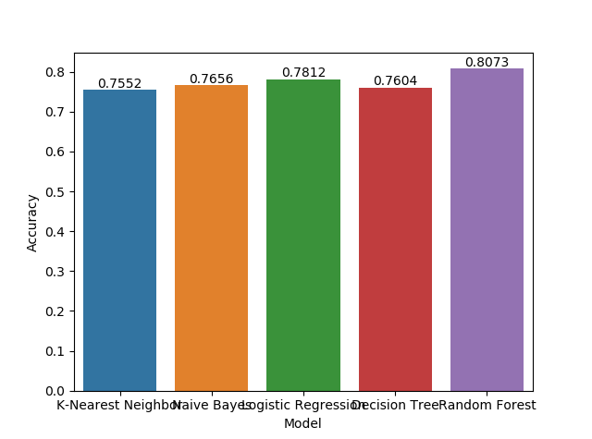
Visual Output: Model Accuracy

Slide 10
Outcome
Based on accuracy score and visualization output,the best prediction model is determined.
In this case the best prediction model is Random Forest with an accuracy score of 80.73%.

